Slide 1
Our React and Node-Powered Electronics Store Project
Discover the future of online electronics shopping through our cutting-edge project built with React and Node. Seamlessly navigate a personalized interface, enjoy real-time updates, and experience secure transactions. Join us in revolutionizing the way you shop for electronic devices – where innovation meets convenience.

Slide 2
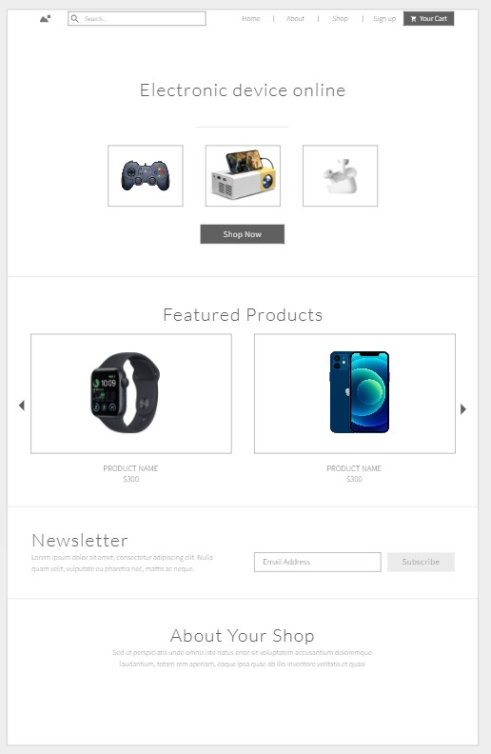
Welcome to Our Innovative Electronics Store Project
Welcome to our project presentation! Dive into the world of innovative online electronics shopping, where React and Node come together to transform your experience. Get ready to explore a dynamic platform that redefines how you shop for tech.

Slide 3

Seamlessly Access Your Account with our Login Page
Seamlessly access your personalized journey through our intuitive login page. Discover how React enhances user interactions, and experience the ease of securely logging into your account, ensuring a tailored shopping adventure.

Slide 4
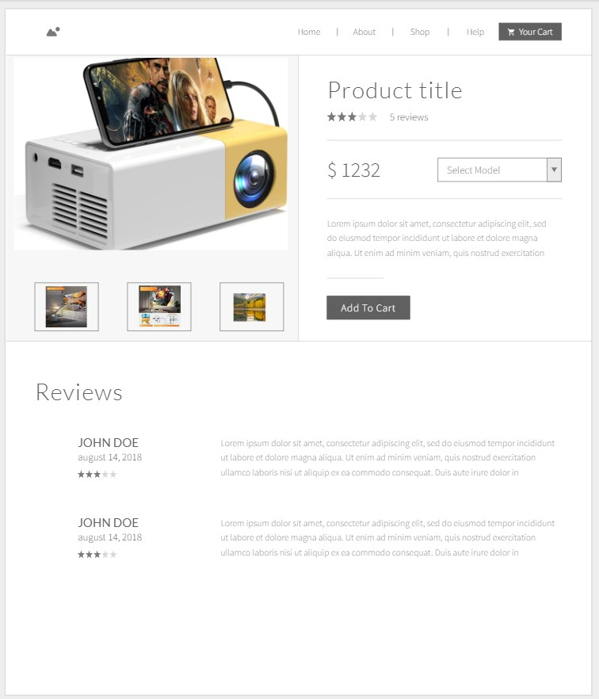
Explore Our Comprehensive Range of Electronics
Immerse yourself in an array of cutting-edge electronics on our platform. Using React, we've curated a dynamic space where you can explore diverse products effortlessly. Swipe, scroll, and interact with an interface designed for discovery.

Slide 5
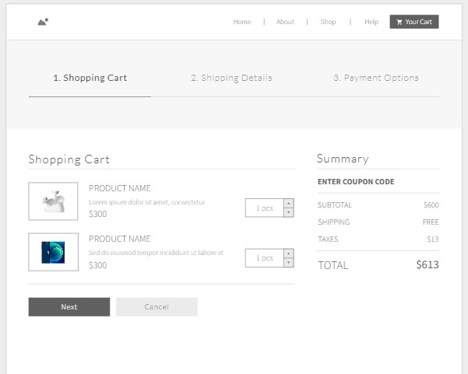
Simplify Your Shopping with Our Shopping Cart
Say goodbye to shopping hassles! See how React's responsiveness makes managing your selections a breeze. Your shopping cart adapts to your needs, allowing you to review, adjust, and finalize your choices with ease.

Slide 6
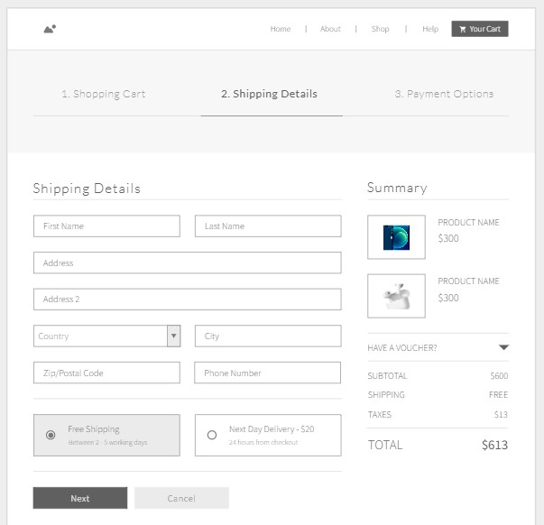
Swift and Reliable Shipping for Your Purchases
Enjoy seamless shipping with Node's real-time capabilities. Experience the excitement of tracking your orders as they make their way to your doorstep. Our website powered by React and Node ensures that your shopping journey is smooth and reliable.

Slide 7
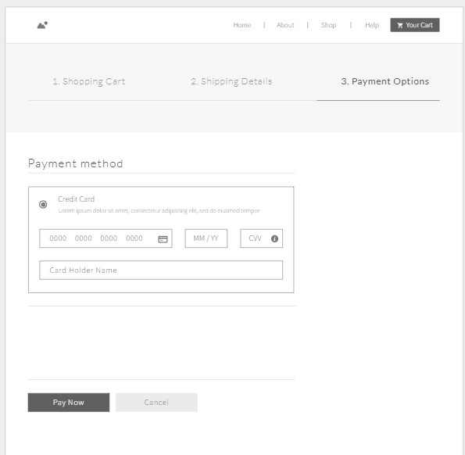
Secure Payment Processing for Hassle-Free Transactions
Secure your purchases with confidence. Witness the power of Node in safeguarding your transactions as you shop. React makes the payment process a breeze, enhancing user experience while ensuring your financial details remain protected

Slide 8
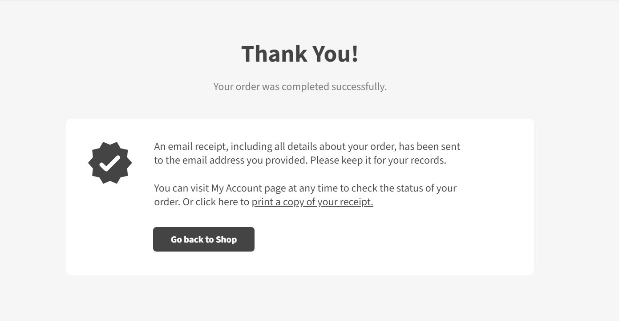
Message - Thanks for Your Shopping
As you conclude your shopping journey, we extend our sincere gratitude for choosing our platform. Thank you for entrusting us with your electronic needs. Rest assured, an email confirmation will soon arrive in your inbox, providing details about your purchase. Your satisfaction is our priority, and we look forward to serving you again.

